Slide 1
Hough Line Transform

Slide 2
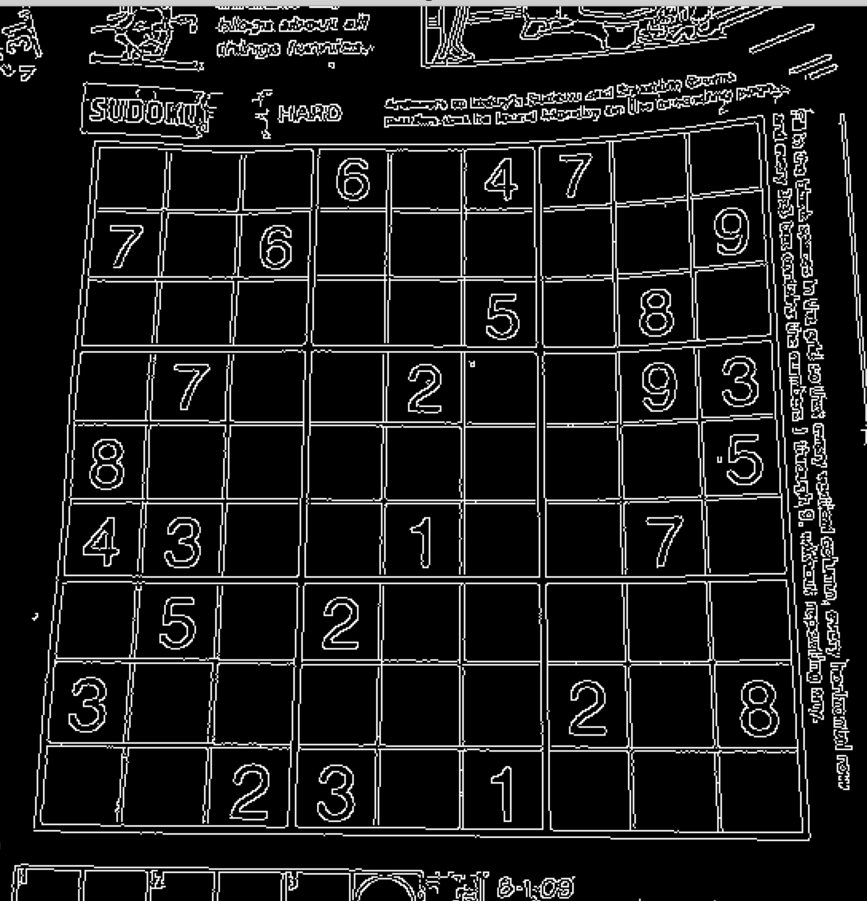
Problems of Edge Detectors
Pre-processing stage to obtain image points or image pixels that are on the desired curve in the image space.
There may be missing points or pixels on the desired curves
Noisy edge points
Mixed types

Slide 3
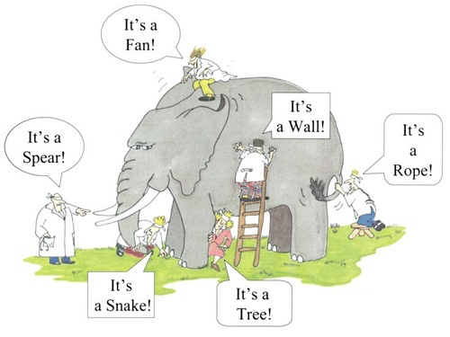
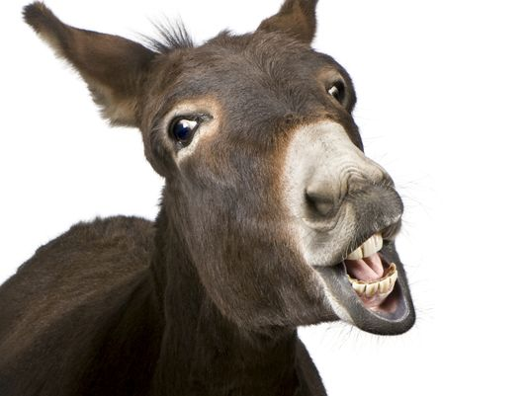
Projective Space

Slide 4
Hough Transform
Hough Transform is a popular technique to detect any shape.
if you can represent that shape in mathematical form. It can detect the shape even if it is broken or distorted a little bit.

Slide 5
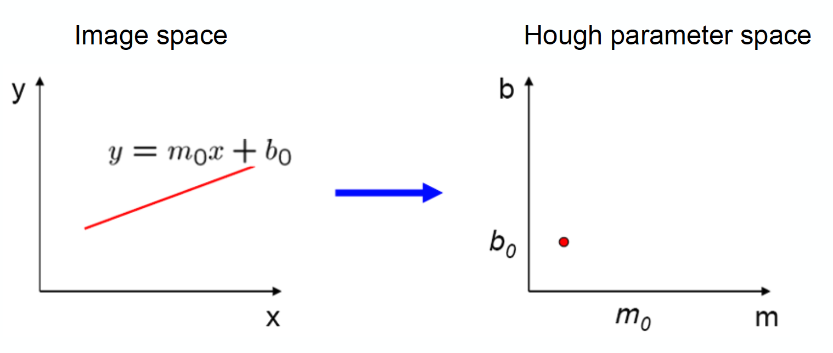
Lines and Points
Parameters
A straight line y = mx + b A point (b, m)
in Cartesian space in the parameter space
figure by S. Seitz

Slide 6
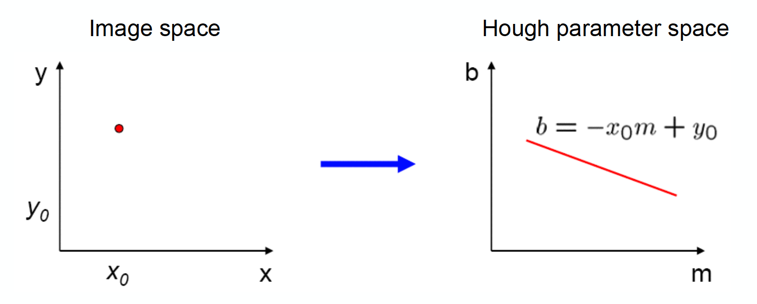
Points and Lines
Parameters
A point (x, y) A straight line y = mx + b in Cartesian space in the parameter space
figure by S. Seitz

Slide 7
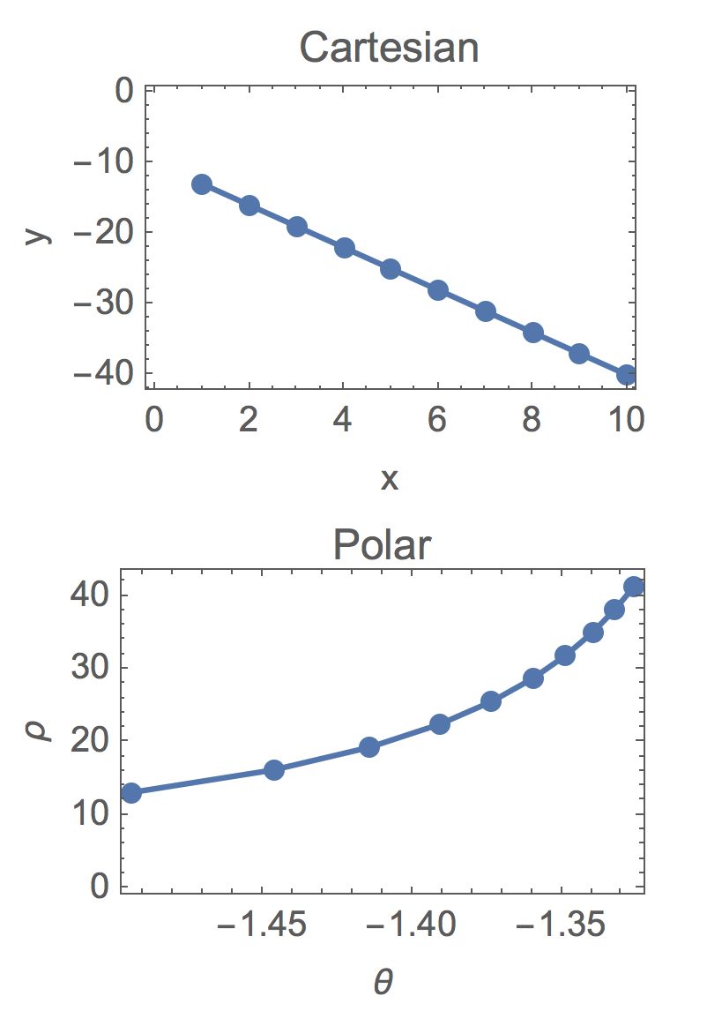
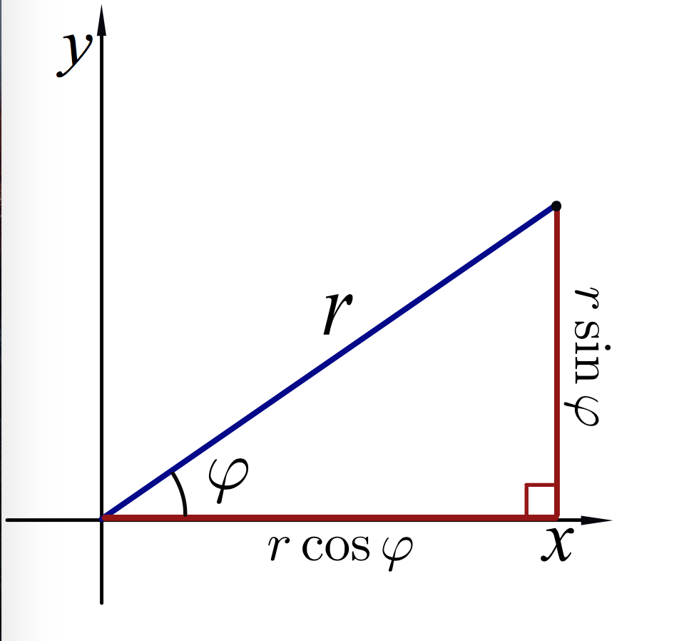
Alternative Representation
Transform Cartesian coordinates to polar coordinates?

Slide 8
Hough Transform
A line can be represented as y = mx+c or in parametric form, as p = x cos θ + y sin θ where p is the perpendicular distance from origin to the line, and theta is the angle formed by this perpendicular line and horizontal axis measured in counter-clockwise ( That direction varies on how you represent the coordinate system. This representation is used in OpenCV).

Slide 9
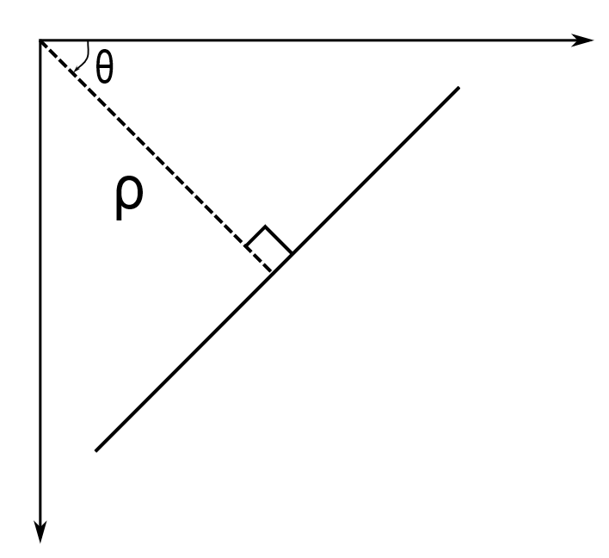
Hough Transform
So if line is passing below the origin, it will have a positive p and angle less than 180. If it is going above the origin, instead of taking angle greater than 180, angle is taken less than 180, and p is taken negative. Any vertical line will have 0 degree and horizontal lines will have 90 degree.

Slide 10
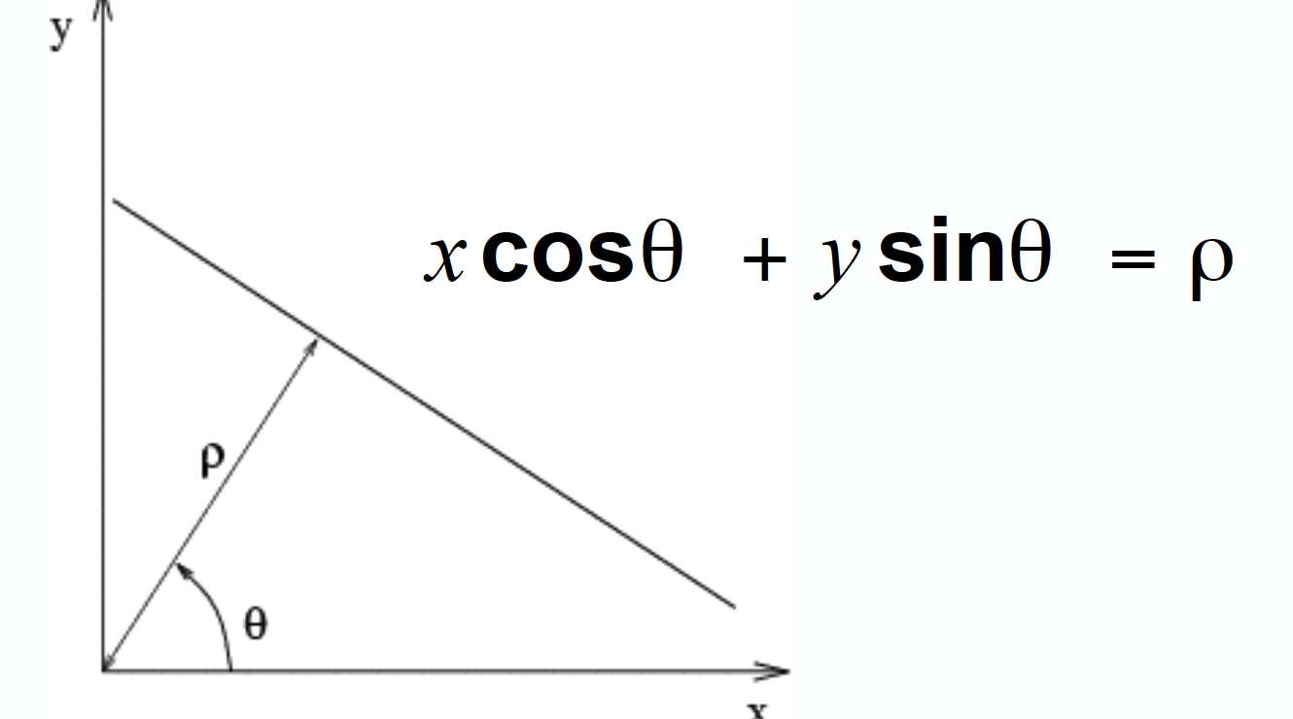
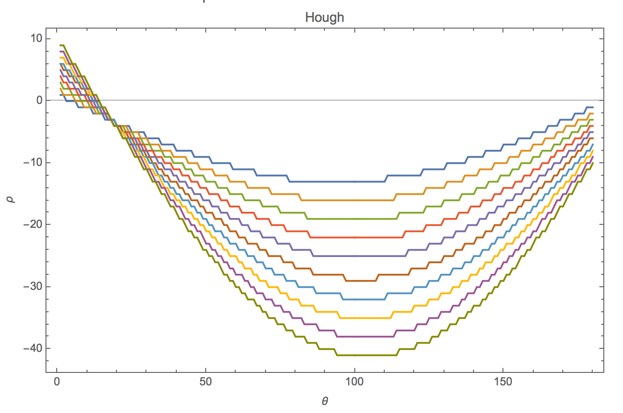
Hough Angle Transform

Slide 11
Hough Transform
Any line can be represented in these two terms, . So first it creates a 2D array or accumulator (to hold values of two parameters) and it is set to 0 initially.
Let rows denote the and columns denote the .
Any line can be represented in these two terms, (p, ɵ). So first it creates a 2D array or accumulator (to hold values of two parameters) and it is set to 0 initially.
Let rows denote the p and columns denote the ɵ .
Size of array depends on the accuracy you need
For p, the maximum distance possible is the diagonal length of the image.

Slide 12
Initialize Accumulator
Let’s say you chose a 10×10 accumulator. It means that p can take only 10 distinct values and the θcan take 10 distinct values, and therefore you will be able to detect 100 different kinds of lines.
Take the first point of the line. You know its (x,y) values.
Now in the line equation, put the values ɵ= 0,1,2,....,180 and check the p you get. For every p, ɵ) pair, you increment value by one in our accumulator in its corresponding p, ɵ) cells.
Now take the second point on the line. Do the same as above.
Increment the values in the cells corresponding to (p, ɵ) you got.

Slide 13
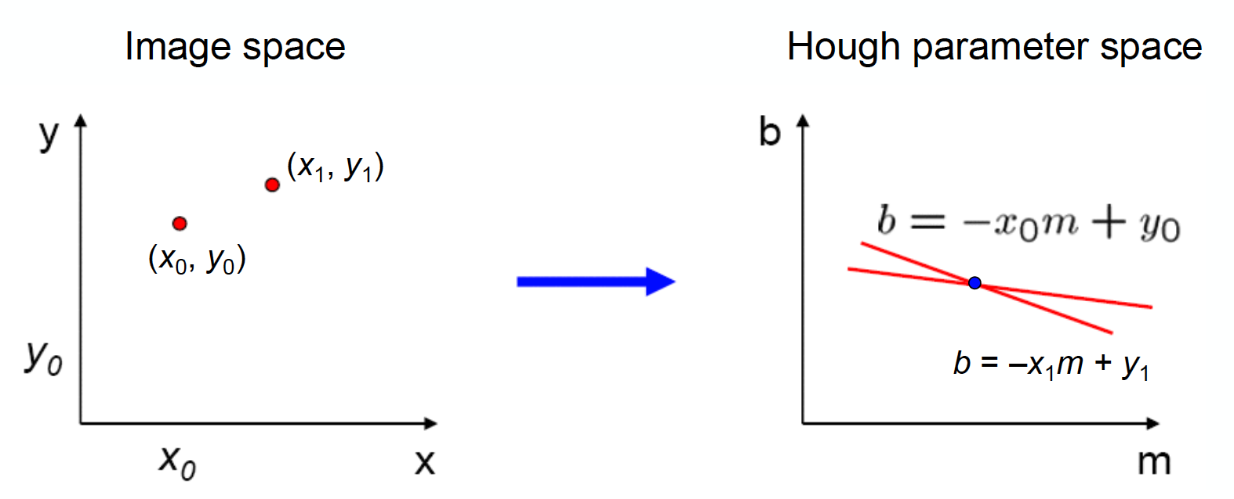
What about Two Points?
What about vertical Lines?
Results in two lines in the Hough parameter space
The intersection point represents the original line.
Every point has a vote

Slide 14
Voting by Edge Pixels
For every edge pixel (x, y) in the above array, we vary the values of θ from 0 to 180 and plug it in equation 1 to obtain a value for p.

Slide 15
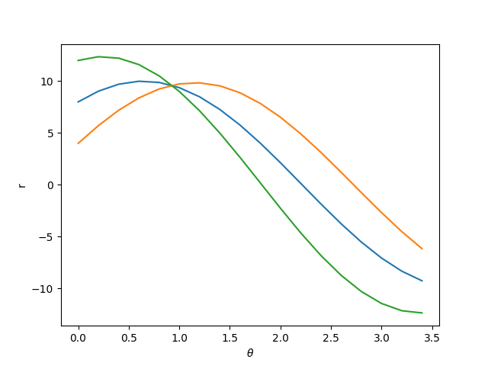

Slide 16
In the Figure we vary the θ for three pixels and obtain the values for p using equation 1.
As you can see, these curves intersect at a point indicating that a line with parameters θ = 1 and p = 9.5 is passing through them.

Slide 17
This time, the cell (50,90) = 2. What you actually do is voting the (p, ɵ) values.
You continue this process for every point on the line. At each point, the cell (50,90) will be incremented or voted up, while other cells may or may not be voted up. This way, at the end, the cell (50,90) will have maximum votes.
So if you search the accumulator for maximum votes, you get the value (50,90) which says, there is a line in this image at distance 50 from origin and at angle 90 degrees.

Slide 18
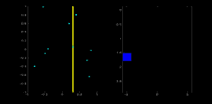

Slide 19
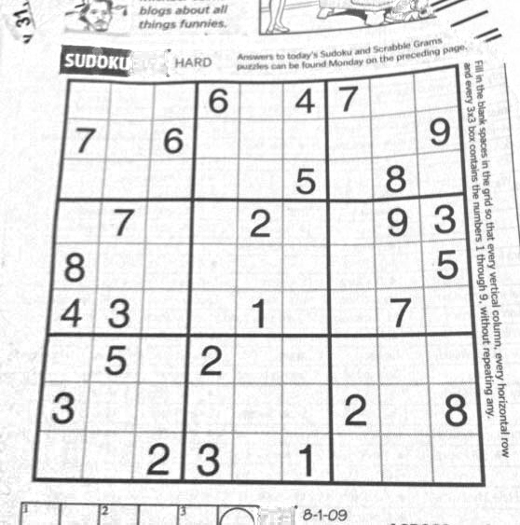
Edge Detector

Slide 20
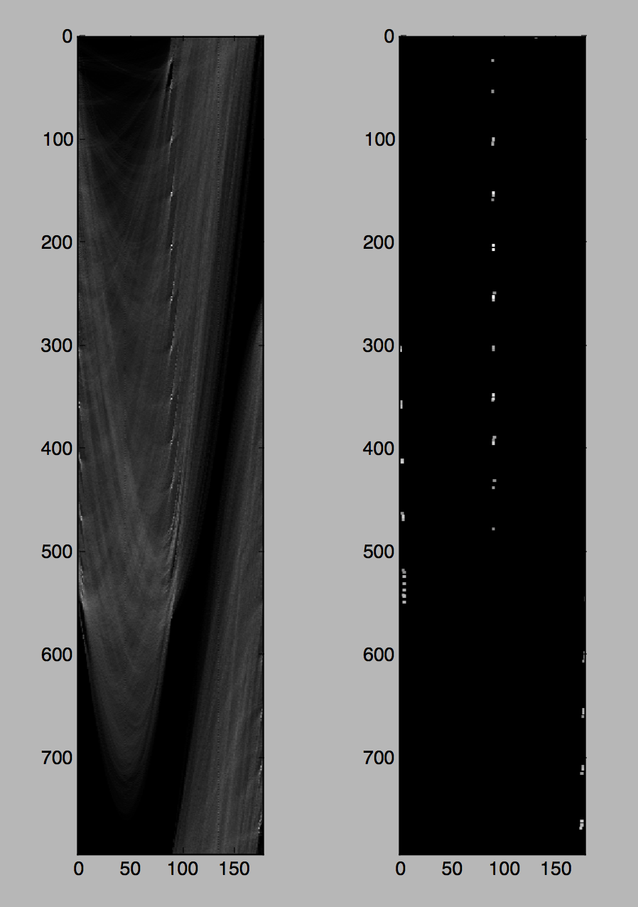
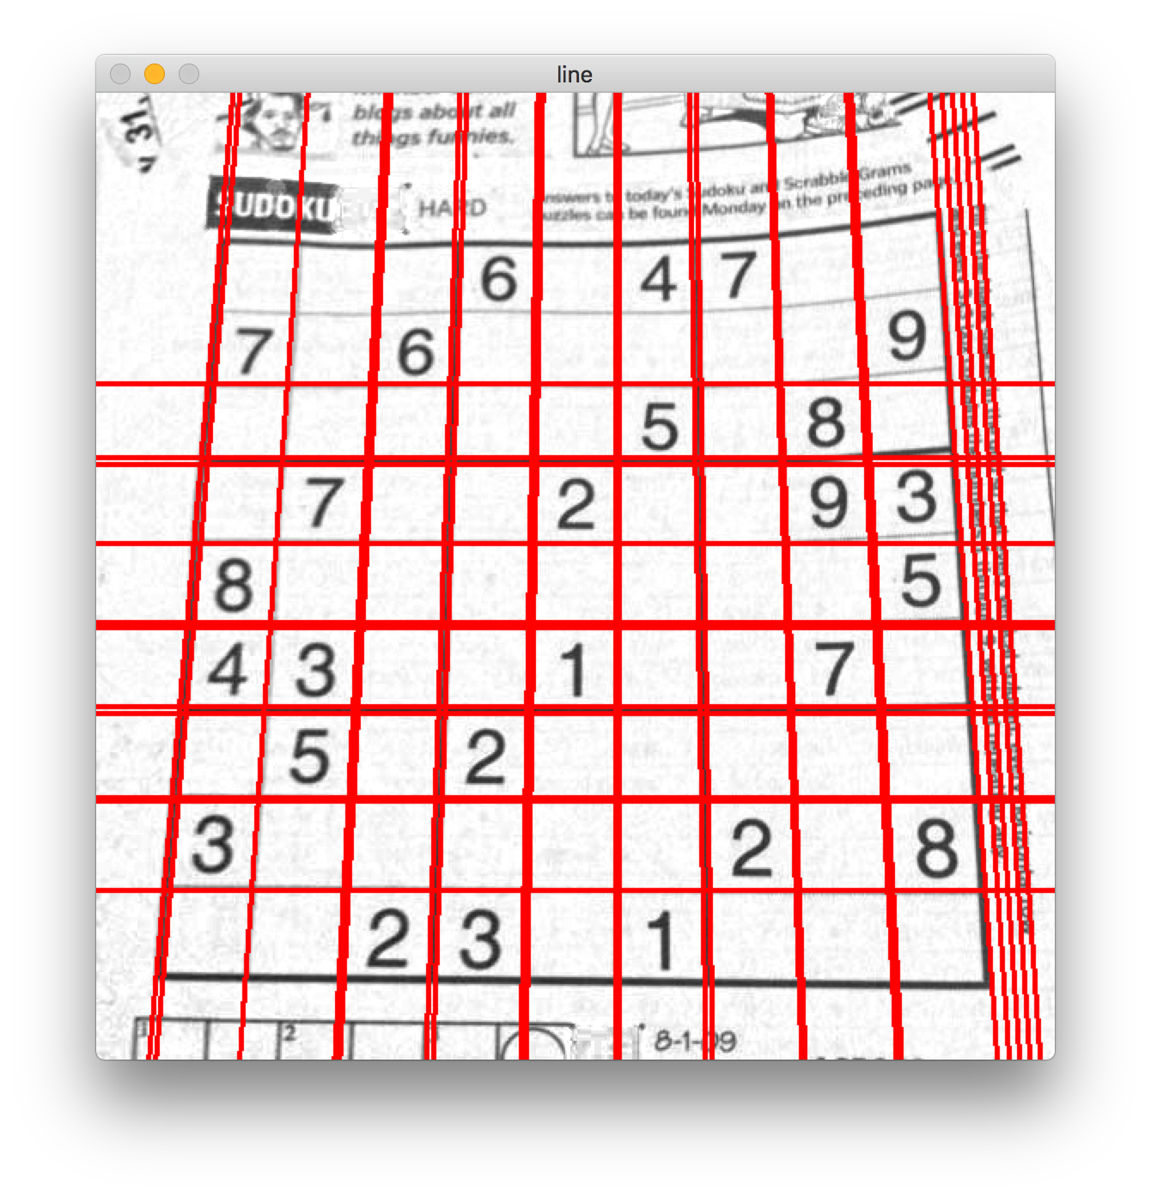
Hough Transform Line Detector

Slide 21
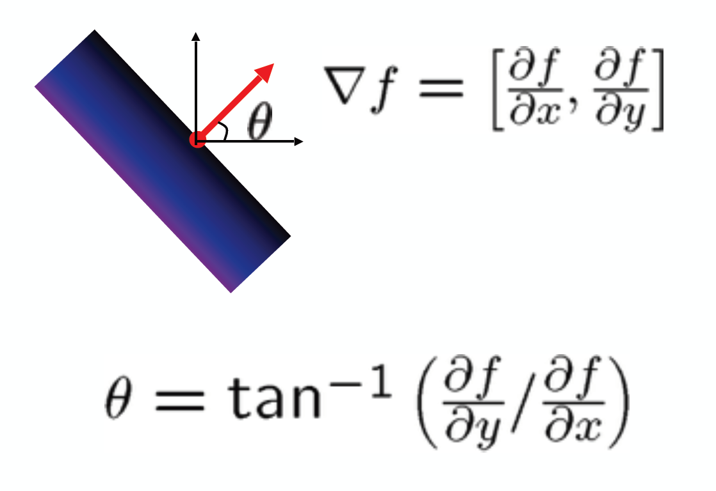
Incorporate with Image Gradients
The edge’s direction can be determined when calculating gradients
Reduce the angle range of each point
Reduce useless votes

Slide 22
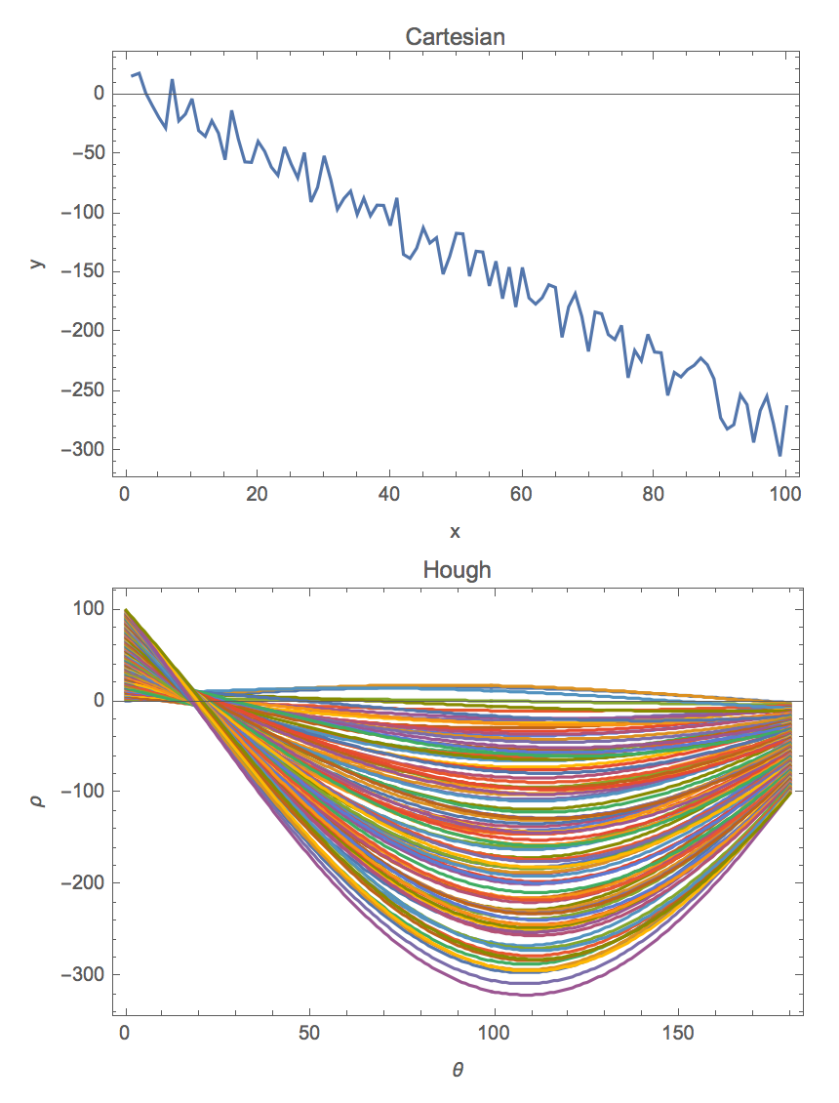
Effect of Noise and Bin Size
Choose proper bin size
- Too coarse: large votes obtained when too many different lines correspond to a single bucket
- Too fine: miss lines because some points that are not exactly collinear cast votes for different buckets
Smooth the voting array
Reduce feature points

Slide 23
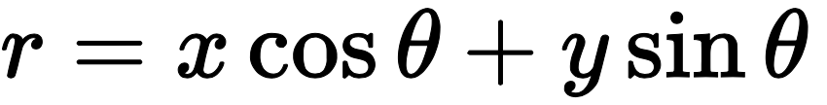
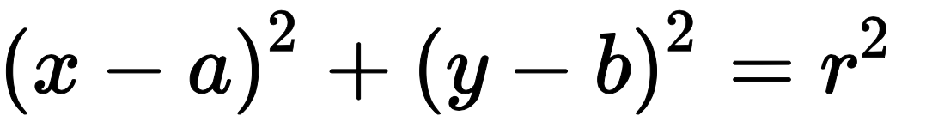
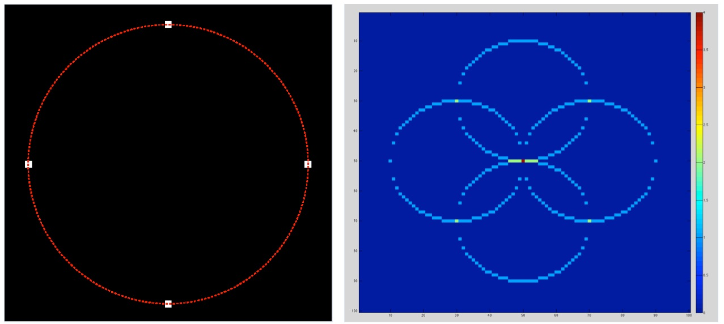
Circle Hough Transform

Slide 24
Circle Hough Transform
A circle is represented mathematically as (x-x_{center}) ² + (y - y_{center}) ² = r² where (x_{center,} y_{center}) is the center of the circle, and r is the radius of the circle.
From equation, 3 parameters, so need a 3D accumulator for hough transform, which would be highly ineffective.
So OpenCV uses more trickier method, Hough Gradient Method which uses the gradient information of edges.

Slide 25
HoughCircles
The following steps are followed to detect circles in an image:
Find the edges in the given image with the help of edge detectors (Canny).
For detecting circles in an image, we set a threshold for the maximum and minimum value of the radius.
Evidence is collected in a 3D accumulator array for the presence of circles with different centers and radii.

Slide 26
cv2.HoughCircles
cv2.HoughCircles(image, circles, method, dp, minDist, param1 = 100, param2 = 100, minRadius = 0, maxRadius = 0)
Parameters:
image:8-bit, single-channel, grayscale input image.
circles:output vector of found circles(cv.CV_32FC3 type). Each vector is encoded as a 3-element floating-point vector (x,y,radius).
method:detection method(see cv.HoughModes). Currently, the only implemented method is HOUGH_GRADIENT

Slide 27
cv2.HoughCircles
Parameters:
dp:inverse ratio of the accumulator resolution to the image resolution. For example, if dp = 1 , the accumulator has the same resolution as the input image. If dp = 2 , the accumulator has half as big width and height.
minDist:minimum distance between the centers of the detected circles. If the parameter is too small, multiple neighbor circles may be falsely detected in addition to a true one. If it is too large, some circles may be missed.
param1:first method-specific parameter. In case of HOUGH_GRADIENT , it is the higher threshold of the two passed to the Canny edge detector (the lower one is twice smaller).

Slide 28
Parameters:
param2:second method-specific parameter. In case of HOUGH_GRADIENT , it is the accumulator threshold for the circle centers at the detection stage. The smaller it is, the more false circles may be detected. Circles, corresponding to the larger accumulator values, will be returned first.
minRadius: minimum circle radius.
maxRadius: maximum circle radius.

Slide 29
